Slide 1
Unit 2
Information Technology

Slide 2
Language features of news
Journalistic terms
contributor
headline news
running stories
criticism
profile
comic strip
supplement
wanted column
express paper
bulletin
tabloid
review news
press office
publisher
chief editor
freelancer
correspondent

Slide 3
Language features of news
Journalistic terms
贡献者
头条新闻
流言蜚语
批评
概况
连环画
补充
通栏
contributor
headline news
running stories
criticism
profile
comic strip
supplement
wanted column
express paper
bulletin
tabloid
review news
press office
publisher
chief editor
freelancer
correspondent
快报
公告
小报
回顾新闻
新闻处
出版者
主编
自由职业者
通讯员

Slide 4

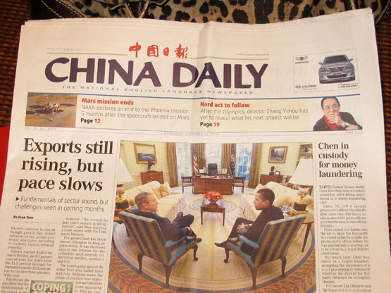
What newspaper or magazine do you know or read?
http://www.hjenglish.com/doc/myexam/104_1644.htm

Slide 5
What newspaper or magazine do you know or read?
《纽约时报》(The New York Times)
《华盛顿邮报》(The Washington Post)
《时代》周刊(Time)
《泰晤士报》(The Times)
《经济学家》(The Economist)
《旁观者》(The Spectator)
著名的通讯社:
美国的美联社(Associated Press，AP)
英国的路透社(Reuter’S News Agency, Reuters)
http://www.hjenglish.com/doc/myexam/104_1644.htm

Slide 6
Language of news: compound word
·
Compound words are made up of two (or more) separate words. You can combine nouns (a flatmate), adjectives (lovesick) or verbs (jump-start) to make compound words.

Slide 7
Three forms of compound words
one word: flatmate, lovesick
two words: tourist guide, travel agent
hyphenated: low-paid (adj.), film-goer (noun)

Slide 8
Noun compounds
(n.+v.)sunrise, earthquake, daybreak, birth-control, haircut, dress-design
(v+n) playboy, watchdog, flashlight, typewriter
(v+prep)drawback, handout, ringback, breakup
swimming pool, waiting room, walking stick
safety belt, chairman, motorcycle

Slide 9
Adjective compounds
heart-breaking, self-defeating
homemade, handmade, handwritten,
hardworking, good-looking, easy-going, well-wishing
widespread, well-meant,
well-timed, upbeat
tax free, self-conscious, grass green ,
smoke-free
·

Slide 10
Verb compounds
housekeep, lip-read
day-dream, window-shop, uplift
Spoon-feed

Slide 11
Compounds with hyphens
The wait-and-see attitude, the life-and-death issue, the hit-and-run accident, the deficit-ridden state-owned enterprise, ready-to-eat food, after-sales service, a hide-and-seek game, a round-the-clock service, a by-no-means negligible role, a difficult-to-operate machine, a never-to-be-forgotten film, a corruption-free country, a terror-stricken country, a heart-in-the-mouth situation, an all-talk-no-action craven, a search-and-rescue mission, a win-win policy, take a “can-do” attitude

Slide 12
The wait-and-see attitude观望的态度,
the life-and-death issue生死攸关的问题,
the hit-and-run accident肇事逃逸的事故,
the deficit-ridden state-owned enterprise亏损的国企
ready-to-eat food,即食的食品
after-sales service售后服务,
a hide-and-seek game捉迷藏的游戏, cat-and-mouse game
a round-the-clock service全天候的服务,
a by-no-means negligible role绝对不可忽视的作用,
a difficult-to-operate machine一台难以操作的机器,
a never-to-be-forgotten film一部永远不会被遗忘的电影,
a corruption-free country一个廉洁的/没有腐败的国家,
a terror-stricken country一个被恐怖笼罩的国家,
a heart-in-the-mouth situation一个惊心动魄的情景
an all-talk-no-action craven一光说不练的懦夫/胆小鬼,
a search-and-rescue mission一个搜救任务,
a win-win policy一个双赢的政策,
take a “can-do” attitude采取积极进取的态度

Slide 13
Disscusion
Do you think governments in China should regulate web hosts or services connecting websites to the internet and how?

